Slide 1

Guided By :- Deepak Gurao Sir
Presented By :- Mahesh Lakade

Slide 2
Logistic regression Algorithm
Logistic regression is one of the most popular Machine Learning algorithms, which comes under the Supervised Learning technique. It is used for predicting the categorical dependent variable using a given set of independent variables.
Logistic regression predicts the output of a categorical dependent variable. Therefore the outcome must be a categorical or discrete value. It can be either Yes or No, 0 or 1, true or False, etc. but instead of giving the exact value as 0 and 1, it gives the probabilistic values which lie between 0 and 1.

Slide 3
Random Forest Algorithm
Random Forest is a popular machine learning algorithm that belongs to the supervised learning technique. It can be used for both Classification an
As the name suggests, "Random Forest is a classifier that contains a number of decision trees on various subsets of the given dataset and takes the average to improve the predictive accuracy of that dataset."
Instead of relying on one decision tree, the random forest takes the prediction from each tree and based on the majority votes of predictions, and it predicts the final output.

Slide 4
Support Vector Machine Algorithm
Support Vector Machine or SVM is one of the most popular Supervised Learning algorithms, which is used for Classification as well as Regression problems. However, primarily, it is used for Classification problems in Machine Learning.
The goal of the SVM algorithm is to create the best line or decision boundary that can segregate n-dimensional space into classes so that we can easily put the new data point in the correct category in the future. This best decision boundary is called a hyperplane.
SVM algorithm can be used for Face detection, image classification, text categorization, etc.

Slide 5
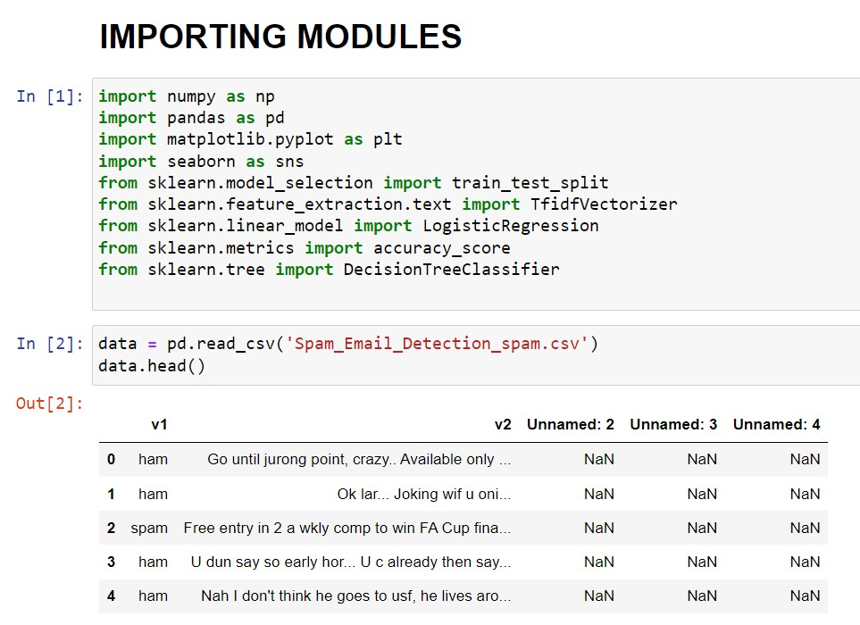
I’m using here (Spam_Email_Detection_spam.csv) dataset to for a creating Spam mail detection model. This Dataset I was download from Kaggle. So let’s start this task by importing the required Python libraries and dataset.

Slide 6
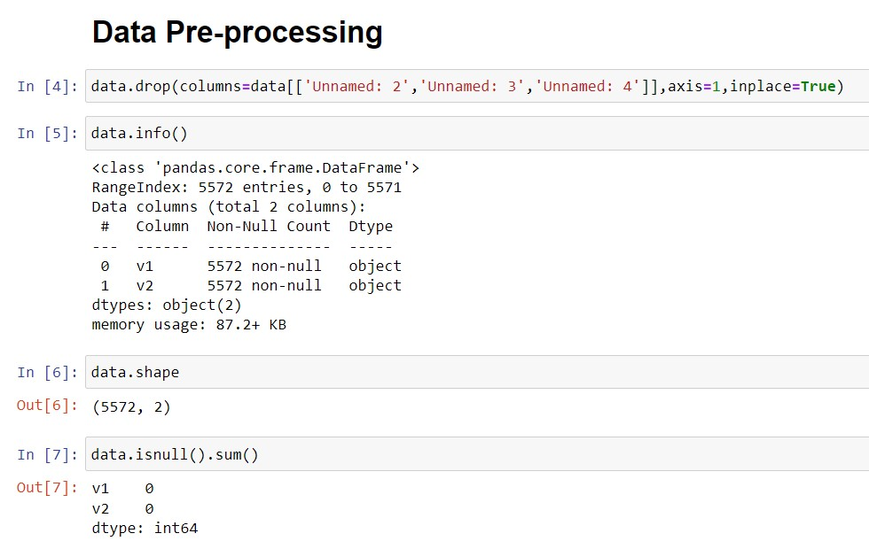
The next step was a Data Pre-processing here I use data.drop() function for removing unnecessary columns. Then using data.info() I was check the columns types Then I was use data.shape() for checking row and columns in the dataset. Then I was use data.isnull().sum() to check null values in the dataset

Slide 7
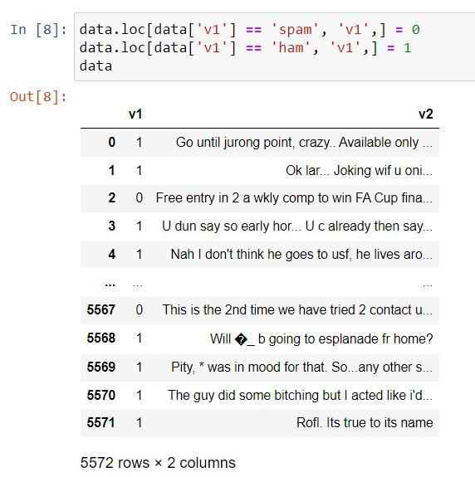
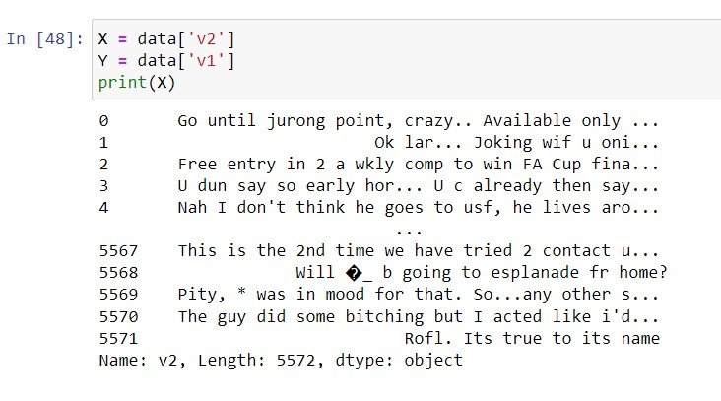
Using data.loc[] I was convert the spam & ham to 0 & 1 format. Then I was use two variable X and Y store the v2 (independent variable) in X & v1 (dependent variable) in Y .

Slide 8
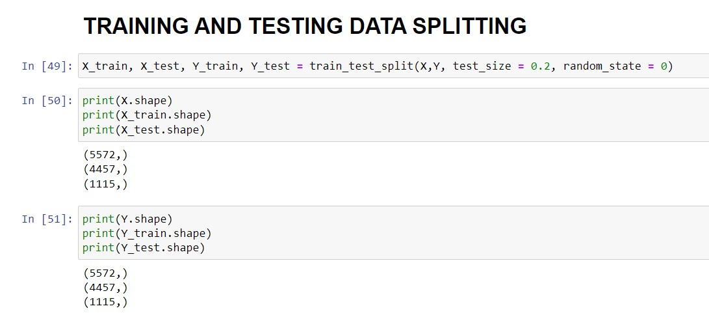
The next step was a training & testing the Dataset , so that’s why we use train_test_split () from the sklearn library. And check the shape of X_train , X_test, Y_train, Y_test.

Slide 9
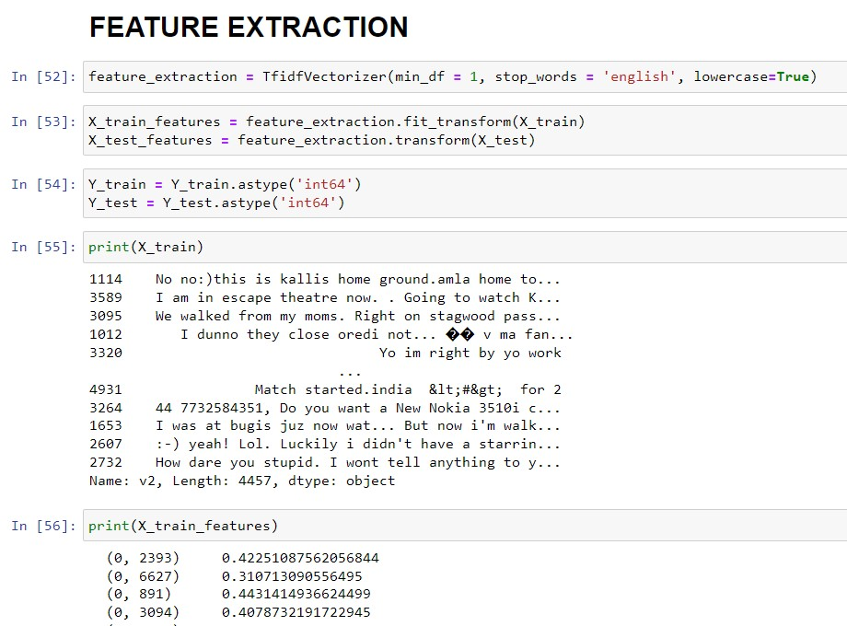
The next step was a Feature Extraction, in the feature extraction converting the raw data into numerical features. In the dataset we convert X_train & X_test to numeric format. And then change the datatype of Y_train & Y_test to integer format.

Slide 10
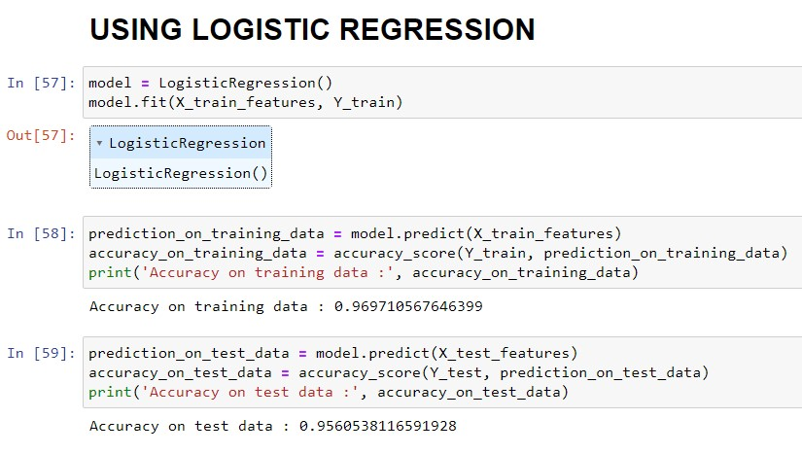
Logistic Regression: So here we use logistic regression model import from sklearn library. Then fit the model using model.fit() Then using model.predict() predict the values and print the accuracy_score of both train data and test data.

Slide 11
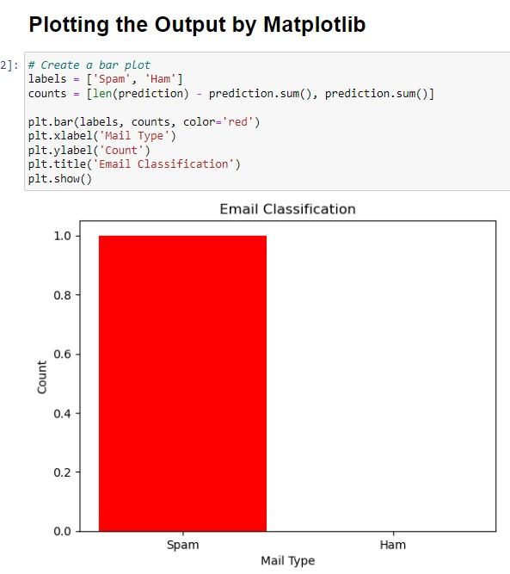
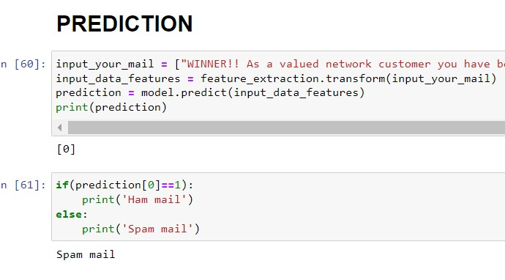
Here I create a input variable and control statement to check the text mail was spam or ham and then I was bar plot to print spam or ham classification.

Slide 12
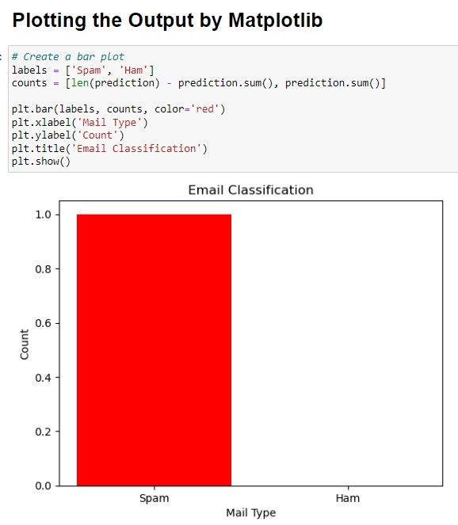
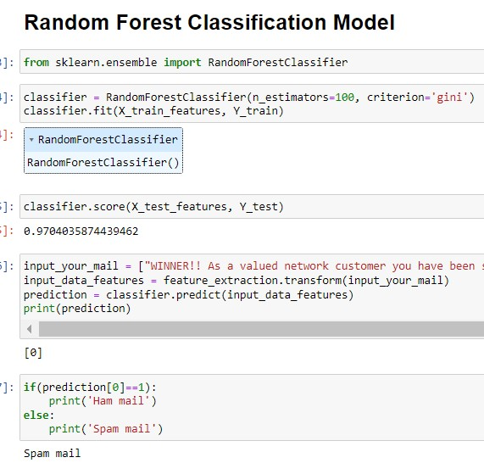
Random Forest : So here we use random forest model import from sklearn library. Then fit the model using classifier.fit() Then using classifier.score() print the score. Then using classifier.predict() predict the values & using control statement predict the spam or ham mail and using plt.bar() print the bar plot .

Slide 13
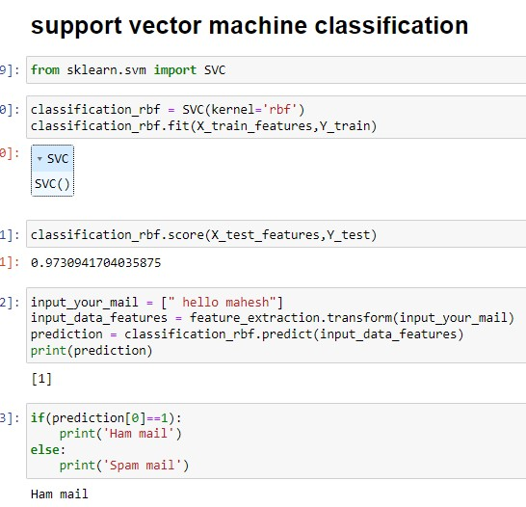
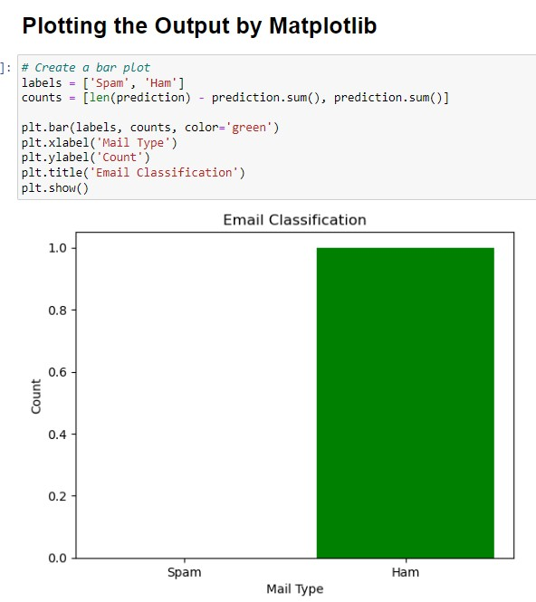
SVM: So here we use SVC model import from sklearn library. Then fit the model using classification_rbf.fit() , Then using classification_rbf.score() print the score. Then using classification_rbf. predict() predict the values. using control statement predict the spam or ham mail and using plt.bar() print the bar plot .

Slide 14
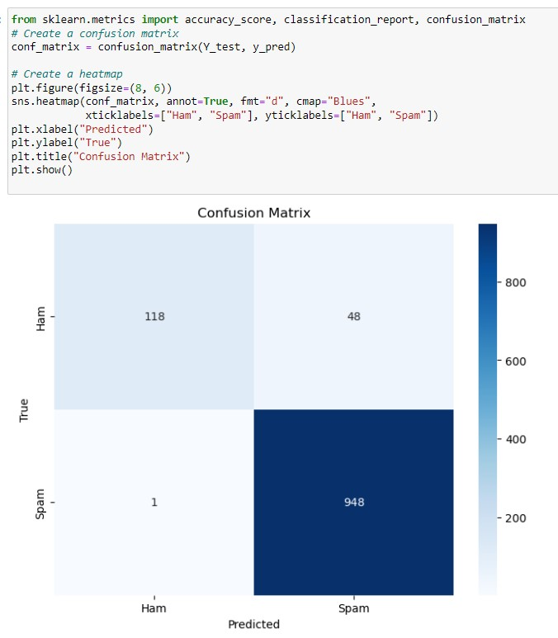
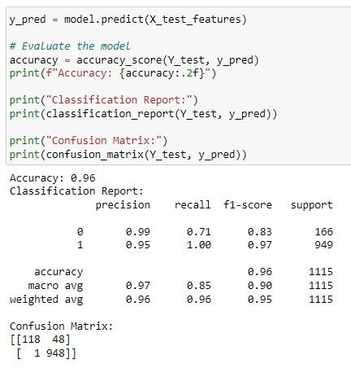
The confusion matrix is used to determine the performance of the classification models for a given set of test data. It helps us to understand how well the model is doing in terms of making correct and incorrect predictions.

Slide 15
Thank You ☺

